Slide 1

20EC5203 ELECTRONIC DESIGN PROJECT- I
Presented by:
KURUKISHAN R (811722106041)
PRAVEENKUMAR A (811722106076)
PRIYA R (811722106077)
Under the Guidance of
Mrs.J.DEEPA, M.Tech(Ph.D).,
ASSISTANT PROFESSOR
DEPARTMENT OF ELECTRONIC AND COMMUNICATION

Slide 2
OUTLINE
MODULE 1
MODULE 2
ABSTRACT
INTRODUCTION
OBJECTIVE
SCOPE,GOALS
LITERATURE SURVEY
BLOCK DIAGRAM
CIRCUIT DIAGRAM
HARDWARE MODULE
ADVANTAGES , APPLICATIONS
ABSTRACT
INTRODUCTION
OBJECTIVE
SCOPE,GOALS
LITERATURE SURVEY
BLOCK DIAGRAM
CIRCUIT DIAGRAM
HARDWARE MODULE
ADVANTAGES, APPLICATIONS
CONCLUSION
REFERENCE

Slide 3
MODULE 1 - BANKING SURVEILLANCE USING IR SENSOR

Slide 4
ABSTRACT - MODULE 1
The "Banking Surveillance Using IR Sensor" project presents an innovative approach to enhancing security in banking environments. This system uses an IR sensor module to detect unauthorized movement or proximity to restricted areas. The circuit employs an IR transmitter and receiver, paired with an LM358 operational amplifier acting as a comparator. Upon detecting motion or object presence, the system triggers an alert mechanism comprising a buzzer and an LED indicator. Designed to be efficient and cost-effective, this solution provides a robust layer of security to deter unauthorized access and enhance monitoring in banks.

Slide 5
INTRODUCTION – MODULE 1
Security is paramount in banking facilities, where financial assets and sensitive data are at risk of theft or breach. Traditional surveillance systems, while effective, can be expensive and complex to deploy. This project proposes a simplified yet effective surveillance mechanism using IR sensor technology. The system works by emitting infrared signals and detecting their reflection when an object or person enters the monitored zone. The compact design, powered by a 9V battery, can be easily integrated into restricted areas, vaults, or ATM booths. The visual and auditory alerts provide real-time notifications to security personnel, ensuring prompt response to potential threats.

Slide 6
OBJECTIVE:
To design a reliable surveillance system for banking environments using IR sensors.
To detect unauthorized movement or proximity to restricted areas.
SCOPE:
Monitoring unauthorized access to vaults or safes.
Providing real-time alerts for better incident response.
GOALS:
To achieve high accuracy in detecting unauthorized activity.
To ensure enhanced security in bank lockers.

Slide 7
LITERATURE SURVEY
REF. NO | TITLE & AUTHOR | METHODOLOGY OR COMPONENTS USED | PROS | CONS
1 | Wireless Sensor Networking of Everyday Objects in a Smart Home Environment & Dipak Surie, Olivier Laguionie, Thomas Pederson | ZigBee-based wireless sensor networking of everyday objects, with 81 sensors on 42 objects in a smart home setup | Wireless sensor networks enable seamless automation of home tasks, enhancing convenience and energy efficiency. | Wireless communication and data sharing among devices increase the risk of privacy breaches and unauthorized access.
2 | A Digital Security System with Door Lock System Using RFID Technology & Gyanendra K Verma, Pawan Tripathi | Passive RFID-based digital security system for door access and user authentication | The RFID-based digital door lock system provides robust access control authorized individuals can enter. | RFID systems may be susceptible to hacking or unauthorized duplication of RFID tags.

Slide 8
3 | Design and Implementation of a WiFi Based Home Automation System & Ahmed ElShafee, Karim Alaa Hamed | WiFi-based home automation system using a server and hardware interface modules to control sensors and actuators | The WiFi-based home automation system allows users to control appliances remotely via a smartphone or computer. | The system’s functionality is heavily reliant on a stable internet connection, leading to potential disruptions during outages.
4 | Design and Implementation of Intelligent Home Control Systems based on Active Sensor Networks & Changsu Suh, Young-Bae Ko | Utilizes wireless sensor/actuator networks (WSAN), LQIR routing protocol, sensors for home automation, security, and management. | Flexibility with sensor-actuator integration , Real testbed implementation , Component-based approach. | Primarily focused on sensors,actuator automation, Limited biometric or advanced security features
5 | Smart Home Design using Wireless Sensor Network and Biometric Technologies & Basma M. Mohammad El-Basioni, Sherine M. Abd El-Kader | Combines wireless sensor networks (WSN) with biometric technologies (fingerprint and palm vein recognition) for security | Enhanced security with biometric integration,Affordable implementation ($6000), Integration with building automation. | Lacks in depth focus on routing protocols,Not implemented on a real testbed

Slide 9
BLOCK DIAGRAM
BATTERY
VARIABLE
RESISTOR
IR RX TX PAIR
LM 358
BUZZER
&
LED

Slide 10
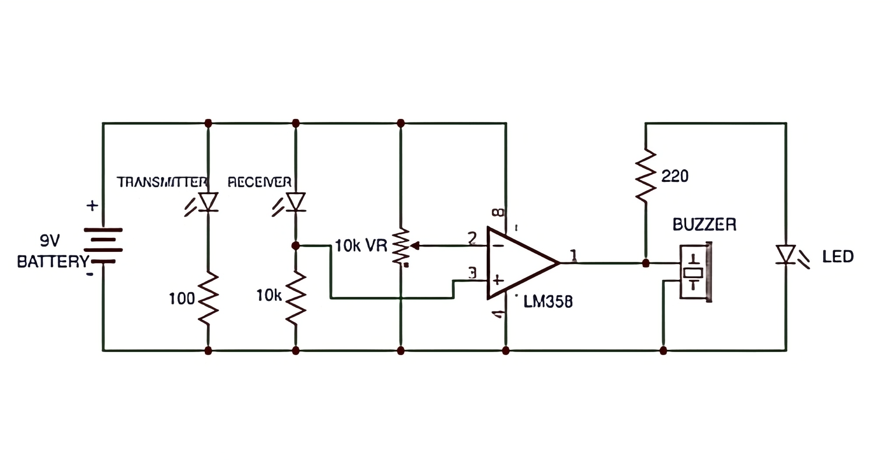
CIRCUIT DIAGRAM

Slide 11
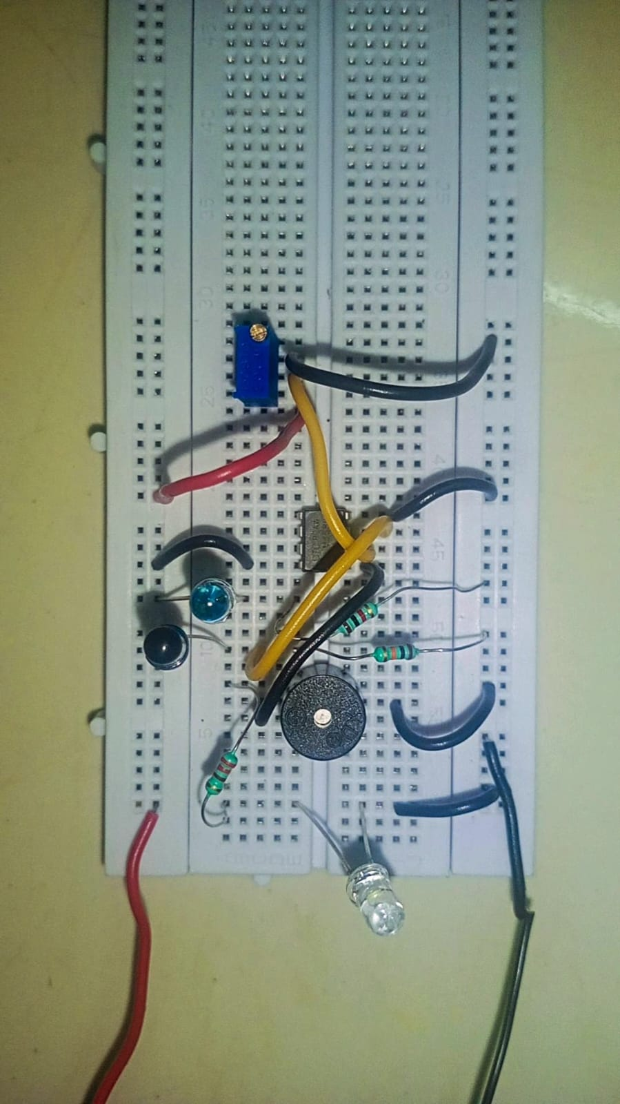
HARDWARE MODULE
https://drive.google.com/file/d/1xcIoyIvkJ4VWybaWCSo_Jozgkfktm655/view?usp=drive_link

Slide 12
ADVANTAGES AND APPLICATIONS
ADVANTAGES
Enhanced Security: The sensor can detect if someone is too close to the locker, helping to prevent unauthorized access.
Automatic Lock/Unlock: The locker can be programmed to automatically lock or unlock when the sensor detects an object or person nearby.
APPLICATION
School and Bank Lockers: For automatic or secure locking systems in schools or Banking sector.
Office Storage: To secure personal belongings or sensitive documents.

Slide 13
MODULE 2 - WATER LEAKAGE DETECTOR

Slide 14
ABSTRACT - MODULE 2
A water leakage detector is a device designed to identify and alert users to water leaks in homes, offices, or other buildings. It typically consists of sensors that detect the presence of water in areas where it shouldn’t be, such as near pipes, appliances, or basements. When the sensor detects water, it triggers an alarm or sends a notification, allowing the problem to be addressed quickly before serious damage occurs. This system helps prevent water damage, saves money on repairs, and reduces the risk of mold growth.

Slide 15
INTRODUCTION – MODULE 2
A water leakage detector is a simple device designed to sense the presence of water in areas where it shouldn't be, such as basements, bathrooms, or under sinks. When it detects water, it sends an alert, allowing you to take action before the leak causes significant damage. These detectors are commonly used to prevent water damage in homes and offices by catching leaks early, ensuring that costly repairs and potential safety hazards are avoided. They are easy to install and provide peace of mind by helping to protect your property from water-related issues.

Slide 16
OBJECTIVE:
Prevent water-related damages to wooden structures, furniture, and other sensitive materials.
Provide an energy-efficient solution suitable for continuous monitoring in water-restricted zones.
SCOPE:
Applicable in wooden houses and wood-related environments to prevent water damage to wooden structures and furniture.
Can be installed near plumbing fixtures, under sinks, or in areas prone to leaks in both residential and commercial buildings.
GOALS:
Provide a cost-effective solution for early detection of water leakage in sensitive and water-restricted environments.
Enhance awareness and quick response to water leaks, ensuring the safety of wooden and other vulnerable materials.

Slide 17
LITERATURE SURVEY
REF. NO | TITLE & AUTHOR | METHODOLOGY OR COMPONENTS USED | PROS | CONS
1 | Automated Water Leak Detection System Using IoT Technology & Dey, N., Ashour, A. S., & Fong, S. J. | IoT sensors and cloud-based monitoring to detect water leaks in real-time | Real-time monitoring, automated alerts, scalable solution | High dependence on internet connectivity
2 | Water Leak Detection in Pipelines Using Machine Learning & Al-Khazraji, H., Gao, Z., & Al-Saedi, H. | Machine learning algorithms for pattern recognition and anomaly detection | High accuracy in leak detection, adaptive learning | Requires large datasets for training, initial setup complexity

Slide 18
3 | Smart Water Leakage Detection System Using Wireless Sensor Networks & Khan, F. M., Ahmad, A., & Iqbal, J. | Wireless sensor networks (WSNs) for distributed leakage detection | Low power consumption, flexible deployment | Limited range and coverage depending on sensor placement
4 | Acoustic-Based Water Pipeline Leak Detection Using Signal Processing Techniques & Muggleton, J. M., Brennan, M. J., & Pinnington, R. J. | Acoustic signal processing techniques to identify leaks via sound analysis | Effective in detecting underground leaks, non-invasive | Sensitive to background noise, requires specialized equipment
5 | Leak Detection in Water Distribution Systems Using Pressure and Flow Monitoring & Colombo, A. F., Lee, P., & Karney, B. W. | Monitoring pressure and flow variations to detect abnormal conditions | High detection accuracy for small and large leaks | Requires continuous monitoring, high initial infrastructure cost

Slide 19
BLOCK DIAGRAM
BATTERY
TRANSISTOR
RAIN SENSOR
IC 555 TIMER
BUZZER

Slide 20
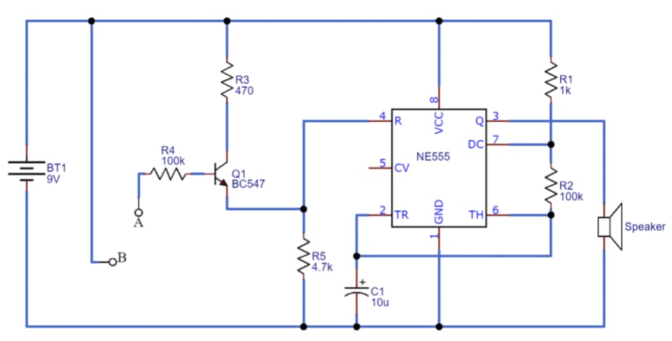
CIRCUIT DIAGRAM
WATER SENSOR

Slide 21
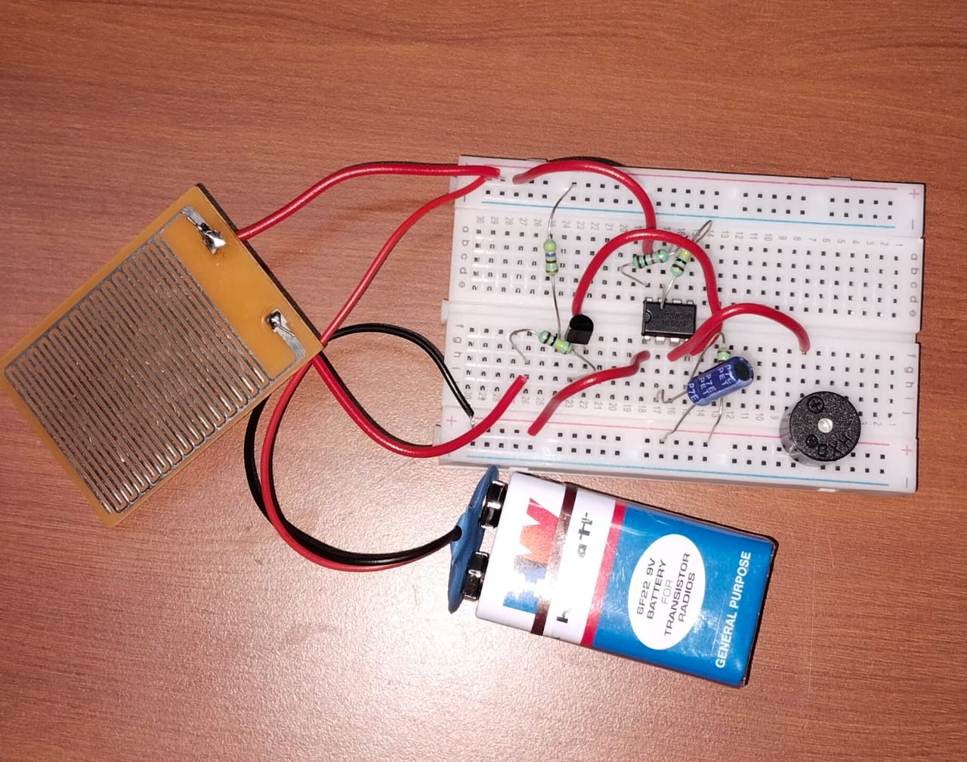
HARDWARE MODULE
https://drive.google.com/file/d/1xZZ2Zp6xuGbXEGIumOZlP5YBOULKnNeJ/view?usp=drive_link

Slide 22
ADVANTAGES AND APPLICATIONS
ADVANTAGES:
Prevention of Water Damage: Water detectors can alert you to leaks or flooding early, preventing extensive damage to property and reducing repair costs.
Safety: Detecting water leaks early can prevent electrical hazards that occur when water comes into contact with electrical systems.
APPLICATION:
Marine Applications: Water detectors are used on ships and boats to detect leaks in the hull or bilge, helping to prevent sinking or other water-related issues.
Residential Use: Water detectors are commonly used in homes to detect leaks in basements, bathrooms, kitchens, laundry rooms, and near water heaters or sump pumps.

Slide 23
CONCLUSION
The IR sensor-based banking surveillance system and water leakage detector demonstrate how simple yet effective technologies can improve safety and convenience. The locker system uses infrared sensors for secure access, demonstrating the potential of combining basic electronics with programming for user-friendly solutions.
The water leakage detector is a crucial tool in property maintenance, providing early alerts for leaks, preventing costly repairs, and reducing water damage and mold growth risks. It integrates sensor technology into practical applications, making it accessible and impactful for a wide range of users, paving the way for smarter, secure, and resilient living and working spaces.

Slide 24
REFERENCES
C. Suh and Y. -B. Ko, "Design and implementation of intelligent home control systems based on active sensor networks," in IEEE Transactions on Consumer Electronics, vol. 54, no. 3, pp. 1177-1184, August 2008.
Tams, B., Mihăilescu, P., Munk, A.: Security considerations in minutiae-based fuzzy vaults. IEEE Trans. Inf. Forensics Secur. 10(5), 985–998 (2015).
Ramani, R., Selvaraju, S., Valarmathy, S., Niranjan, P.: Bank locker security system based on RFID and GSM technology. Int. J. Comput. Appl. 57(18), 15–20 (2012).
Bucko, J.: Security of smart banking applications in Slovakia. J. Theor. Appl. Electron. Commer. Res. 12(1), 42–52 (2017).
Ray, R.K., Uddin, M.A., Islam, S.F.: GSM based bank vault security system. Int. J. Comput. Sci. Inf. Secur. (IJCSIS) 14(2), 35–38 (2016).

Slide 25
Dey, N., Ashour, A. S., & Fong, S. J. (2018). "Automated water leak detection system using IoT technology." Journal of Network and Computer Applications, 108, 54-60.
Al-Khazraji, H., Gao, Z., & Al-Saedi, H. (2020). "Water leak detection in pipelines using machine learning algorithms." Sensors, 20(12), 3362.
Khan, F. M., Ahmad, A., & Iqbal, J. (2019). "Smart water leakage detection system using wireless sensor networks." IEEE Access, 7, 104487-104496.
Muggleton, J. M., Brennan, M. J., & Pinnington, R. J. (2017). "Acoustic-based water pipeline leak detection using signal processing techniques." Journal of Sound and Vibration, 310(1), 246-262.
Colombo, A. F., Lee, P., & Karney, B. W. (2009). "Leak detection in water distribution systems using pressure and flow monitoring." Journal of Water Resources Planning and Management, 135(6), 685-693.

Slide 26
THANK YOU

